Slide 1
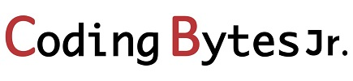

Slide 2
Python

Slide 3
What is python?

Slide 4
Python is a dynamically typed, General Purpose Programming Language that supports an object-oriented programming approach as well as a functional programming approach.
Python is also an interpreted and high-level programming language.
It was created by Guido Van Rossum in 1989.

Slide 5
Why Python ?

Slide 6
Python is simple and easy to understand.
It is Interpreted and platform-independent which makes debugging very easy.
Python is an open-source programming language.

Slide 7
Python provides very big library support. Some of the popular libraries include NumPy, Tensorflow, Selenium, OpenCV, etc.
It is possible to integrate other programming languages within python.

Slide 8
What is Python used for

Slide 9
Python is used in Data Visualization to create plots and graphical representations.
Python helps in Data Analytics to analyze and understand raw data for insights and trends.
It is used in AI and Machine Learning to simulate human behavior and to learn from past data without hard coding.

Slide 10
It is used to create web applications.
It can be used to handle databases.
It is used in business and accounting to perform complex mathematical operations along with quantitative and qualitative analysis.

Slide 11
What are translators?

Slide 12
S.No. | Compiler | Interpreter
1. | The compiler scans the whole program in one go. | Translates the program one statement at a time.
2. | As it scans the code in one go, the errors (if any) are shown at the end together. | Considering it scans code one line at a time, errors are shown line by line.
3. | The main advantage of compilers is its execution time. | Due to interpreters being slow in executing the object code, it is preferred less.
4. | It converts the source code into object code. | It does not convert source code into object code instead it scans it line by line

Slide 13
S.No. | Compiler | Interpreter
5 | It does not require source code for later execution. | It requires source code for later execution.
6 | Execution of the program takes place only after the whole program is compiled. | Execution of the program happens after every line is checked or evaluated.
7 | The machine code is stored in the disk storage. | Machine code is nowhere stored.
8 | Compilers more often take a large amount of time for analyzing the source code. | In comparison, Interpreters take less time for analyzing the source code.

Slide 14
S.No. | Compiler | Interpreter
9. | It is more efficient. | It is less efficient.
10. | CPU utilization is more. | CPU utilization is less.
Eg. | C, C++, C#, etc are programming languages that are compiler-based. | Python, Ruby, Perl, SNOBOL, MATLAB, etc are programming languages that are interpreter-based.

Slide 15
What is Syntax?

Slide 16
In simplest words, Syntax is the arrangement of words and phrases to create well-formed sentences in a language.
In the case of a computer language, the syntax is the structural arrangement of comments, variables, numbers, operators, statements, loops, functions, classes, objects, etc. which helps us understand the meaning or semantics of a computer language.

Slide 17
For E.g. a block of code is identified by an ‘indentation’. Have a look at the following code, here print(i) is said to be indented with respect to the link above it. In simple words, indentation is the addition of spaces before the line "print(i)“
for i in range(5):
print(i)

Slide 18
How to write code is python

Slide 19
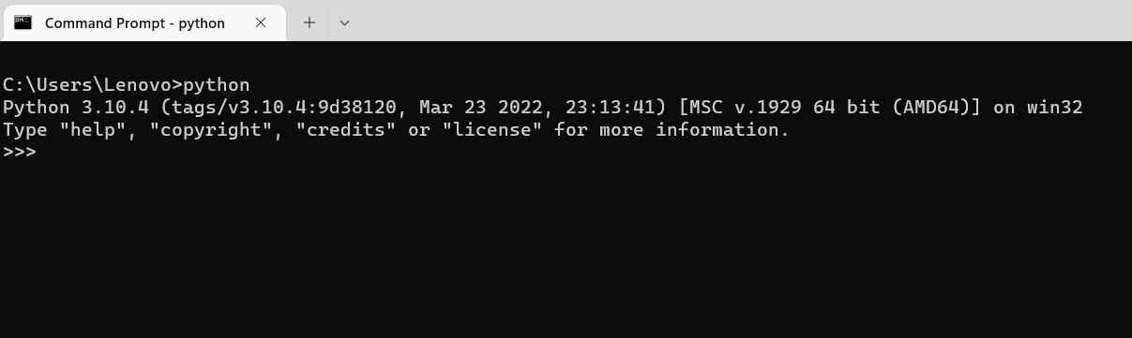
We can write code in python in two ways: 1. Interactive
2. File mode
Interactive mode: we can write code in command prompt > python
File mode: for file mode we can use IDEs such as Visual Studio, Pycharm etc.

Slide 20
Python Comments

Slide 21
A comment is a part of the coding file that the programmer does not want to execute, rather the programmer uses it to either explain a block of code or to avoid the execution of a specific part of code while testing.
Single-Line Comments:
To write a comment just add a ‘#’ at the start of the line.
Example 1:
#This is a 'Single-Line Comment’
print("This is a print statement.")

Slide 22
Multi-Line Comments:
To write multi-line comments you can use ‘#’ at each line or you can use the multiline string.
"""This is an if-else statement.
It will execute
a block of code if a specified condition is true.
If the condition is false then it will execute another block of code."""
p = 7
if (p > 5):
print("p is greater than 5.")
else:
print("p is not greater than 5.")

Slide 23
What are Variables ?

Slide 24
Variables act as a container in programing language and is use to store data.
Programs use variables to access and manipulate data that is stored in memory.
A variable is a name that represents a value in the computer’s memory.

Slide 25
Naming rule for variables
A variable name can be of any size
A variable name have allowed characters, which are a-z, A-Z, 0-9 and underscore (_)
A variable name should begin with an alphabet or underscore
A variable name should not be a keyword
A variable name cannot contain spaces.
Uppercase and lowercase characters are distinct.

Slide 26
The scope of the variable is the area within which the variable has been created. Based on this a variable can either have a local scope or a global scope.
There are two types of Scope of variable:
Local Variables
Global Variables
Local :- A local variable is created within a function and can be only used inside that function. Such a variable has a local scope.

Slide 27
Global :- A global variable is created in the main body of the code and can be used anywhere within the code. Such a variable has a global scope.
icecream = "Vanilla" #global variable
def foods():
vegetable = "Potato" #local variable
global number
number=10
fruit = "Lichi" #local variable
print(vegetable + " is a local variable value.")
foods()
print(icecream + " is a global variable value.")
print(fruit + " is a local variable value.")
print(number+”is a global variable”)

Slide 28
What are Keywords ?

Slide 29
There are some reserved words in Python which have predefined meaning called keywords.
These words may not be used as variable name.
Some keywords are:
and | del | from | Not | while
as | elif | global | or | with
assert | else | If | pass | yield
break | except | import | print
class | exec | in | raise
continue | finally | is | return
def | for | lambda | try

Slide 30
Data types

Slide 31
Data Type
Numeric
String
Boolean
Sequence
Mapping
Int
Float
Complex
String
Bool
List
Tuple
Sets
Dictionary

Slide 32
Conditional Statments

Slide 33
Decision-making statements in programming languages decide the direction of the flow of program execution.
If the expression evaluates to False, then the program execution follows a different path then it would have if the expression had evaluated to True.
Based on this, the conditional statements are further classified into following types; if, if……else, elif, nested if.

Slide 34
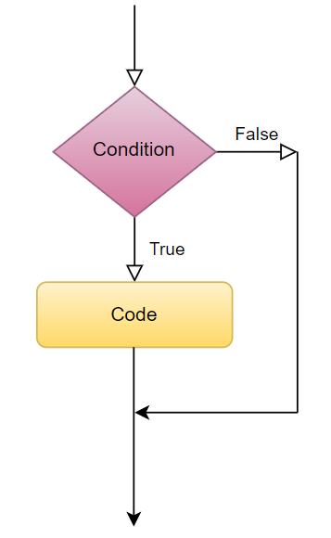
if Statement:
A simple if statement works on following principle,
execute the block of code inside if statement if the expression evaluates True.
ignore the block of code inside if statement if the expression evaluates False and return to the code outside if statement.
Example:
applePrice = 180
budget = 200
if (applePrice <= budget):
print("Alexa, add 1kg Apples to the cart.")

Slide 35
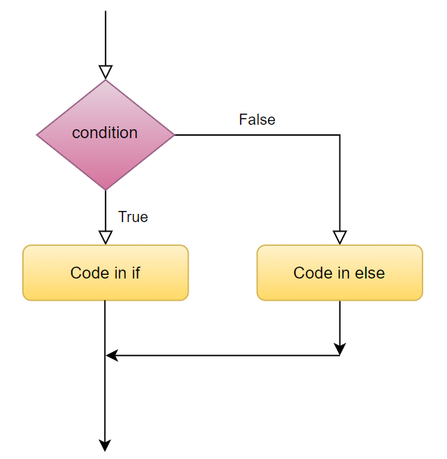
if-else Statement
An if……else statement works on the following principle,
execute the block of code inside if statement if the expression evaluates True. After execution return to the code out of the if……else block.
execute the block of code inside else statement if the expression evaluates False. After execution return to the code out of the if……else block.
Example
applePrice = 210
budget = 200
if (applePrice <= budget):
print("Alexa, add 1kg Apples to the cart.")
else:
print("Alexa, do not add Apples to the cart.")

Slide 36
elif Statement
Sometimes, the programmer may want to evaluate more than one condition, this can be done using an elif statement.
An elif statement works on the following principle,
execute the block of code inside if statement if the initial expression evaluates to True. After execution return to the code out of the if block.
execute the block of code inside the first elif statement if the expression inside it evaluates True. After execution return to the code out of the if block.
execute the block of code inside the second elif statement if the expression inside it evaluates True. After execution return to the code out of the if block.
execute the block of code inside the nth elif statement if the expression inside it evaluates True. After execution return to the code out of the if block.
execute the block of code inside else statement if none of the expression evaluates to True. After execution return to the code out of the if block.

Slide 37
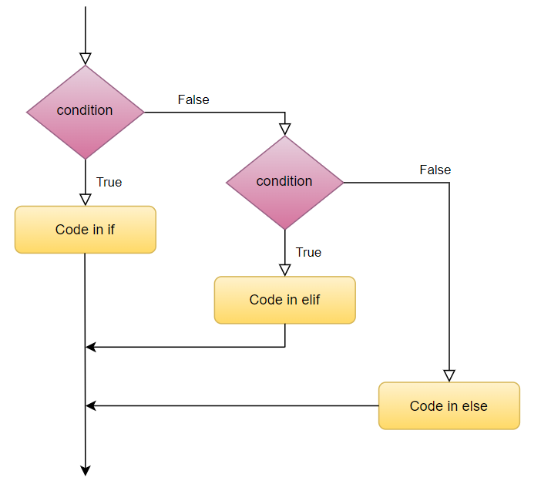
Example:
num = 0
if (num < 0):
print("Number is negative.")
elif (num == 0):
print("Number is Zero.")
else:
print("Number is positive.")

Slide 38
Nested if Statement
We can use if, if….else, elif statements inside other if statements.
Example:
num = 18
if (num < 0):
print("Number is negative.")
elif (num > 0):
if (num <= 10):
print("Number is between 1-10")
elif (num > 10 and num <= 20):
print("Number is between 11-20")
else:
print("Number is greater than 20")
else:
print("Number is zero")

Slide 39
Loops

Slide 40
Sometimes a programmer wants to execute a group of statements a certain number of times. This can be done using loops. Based on this loops are further classified into following types; for loop, while loop, nested loops.
for Loop
for loops can iterate over a sequence of iterable objects in python. Iterating over a sequence is nothing but iterating over strings, lists, tuples, sets and dictionaries.
Example:
name = 'Abhishek'
for i in name:
print(i, end=", ")
Example2 :
colors = ("Red", "Green", "Blue", "Yellow")
for x in colors:
print(x)

Slide 41
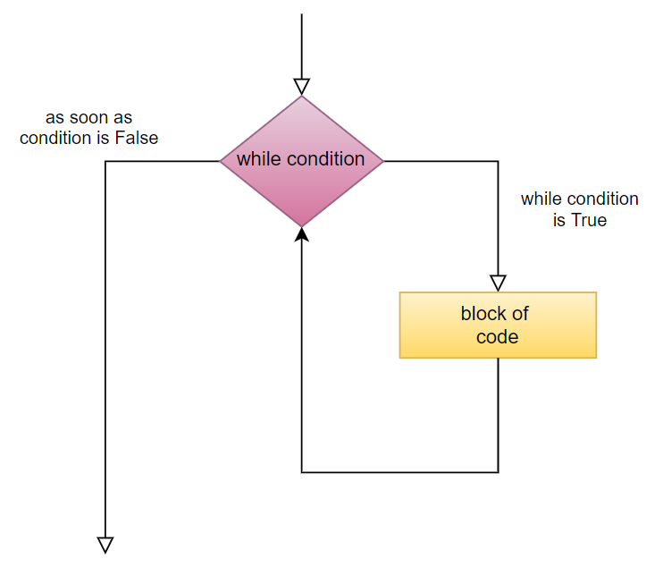
Python while Loop
As the name suggests, while loops execute statements while the condition is True. As soon as the condition becomes False, the interpreter comes out of the while loop.
We can even use the else statement with the while loop. Essentially what the else statement does is that as soon as the while loop condition becomes False, the interpreter comes out of the while loop and the else statement is executed.
Example:
x = 5
while (x > 0):
print(x)
x = x - 1
else:
print('counter is 0')

Slide 42
Control Statements
There are three control statements that can be used with for and while loops to alter their behavior.
They are pass, continue and break.
1. pass:
Whenever loops, functions, if statements, classes, etc are created, it is needed that we should write a block of code in it. An empty code inside loop, if statement or function will give an error.
Example:
i = 1
while (i<5):
pass
for j in range(5):
pass
if (i == 2):
pass

Slide 43
2. continue:
This keyword is used in loops to end the current iteration and continue the next iteration of the loop. Sometimes within a loop, we might need to skip a specific iteration. This can be done using the continue keyword.
Example 1:
for i in range(1,10):
if(i%2 == 0):
continue
print(i)

Slide 44
3. break:
The break keyword is used to bring the interpreter out of the loop and into the main body of the program. Whenever the break keyword is used, the loop is terminated and the interpreter starts executing the next series of statements within the main program.
Example 1:
i = 1
while (i <= 10):
i = i + 1
if (i == 5):
break
print(i)

Slide 45
Functions

Slide 46
Python Modules
Python modules are python files that contain python code that we can use within our python files ensuring simplicity and code reusability.
Here are some popular python built-in modules:
csv, datetime, json, math, random, sqlite3, statistics, tkinter, turtle, etc.
Python Packages
Python packages are essentially folders that contain many python modules. As such, packages help us to import modules from different folders.
Here are some packages provided by python,
NumPy, SciPy, Pandas, Seaborn, sklearn, Matplotlib, etc.

Slide 47
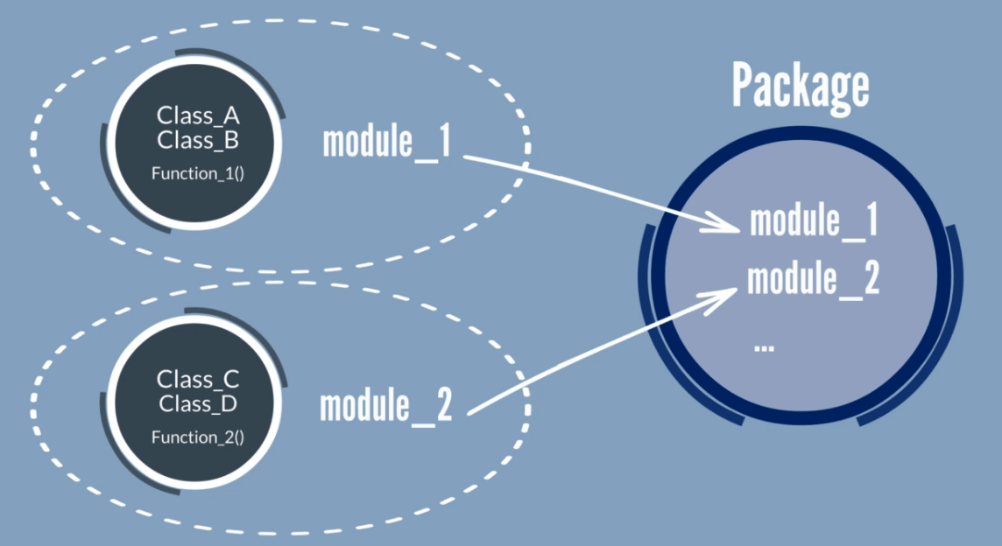

Slide 48
A function in Python is a block of statements that has a name and can be executed by calling it from some other place in your program.
Functions are used to divide complicated programs into manageable pieces.
There are two types of functions:
built-in functions
user-defined functions
1. built-in functions:
These functions are defined and pre-coded in python. Some examples of built-in functions are as follows:
min(), max(), len(), sum(), type(), range(), dict(), list(), tuple(), set(), print(), etc.

Slide 49
2. user-defined functions:
We can create functions to perform specific tasks as per our needs. Such functions are called user-defined functions.
Syntax:
def function_name(parameters):
{Body}
Call a function:
We call a function by giving the function name, followed by parameters (if any) in the parenthesis.
Eg: def name(fname, lname):
print("Hello,", fname, lname)
name("Sam", "Wilson")

Slide 50
Function Arguments
Parameters - are the value which are given to the function at the time of function definition
Arguments - are the value pass to the function when the function is call
There are four types of arguments that we can provide in a function:
Default Arguments
Keyword Arguments
Required Arguments
Variable-length Arguments

Slide 51
1. Default arguments:
We can provide a default value while creating a function. This way the function assumes a default value even if a value is not provided in the function call for that argument.
Example:
def name(fname, mname = "Jhon", lname = "Whatson"):
print("Hello,", fname, mname, lname)
name("Amy")
2. Keyword arguments:
We can provide arguments with key = value, this way the interpreter recognizes the arguments by the parameter name. Hence, the the order in which the arguments are passed does not matter.
Example:
def name(fname, mname, lname):
print("Hello,", fname, mname, lname)
name(mname = "Peter", lname = "Wesker", fname = "Jade")

Slide 52
3. Required arguments:
In case we don’t pass the arguments with a key = value syntax, then it is necessary to pass the arguments in the correct positional order and the number of arguments passed should match with actual function definition.
Example 1: when number of arguments passed does not match to the actual function definition.
def name(fname, mname, lname):
print("Hello,", fname, mname, lname)
name("Peter", "Quill")
Example 2: when number of arguments passed matches to the actual function definition.
def name(fname, mname, lname):
print("Hello,", fname, mname, lname)
name("Peter", "Ego", "Quill")

Slide 53
4. Variable-length arguments:
Sometimes we may need to pass more arguments than those defined in the actual function. This can be done using variable-length arguments.
There are two ways to achieve this:
Arbitrary Arguments:
While creating a function, pass a * before the parameter name while defining the function. The function accesses the arguments by processing them in the form of tuple.
Example:
def name(*name):
print("Hello,", name[0], name[1], name[2])
name("James", "Buchanan", "Barnes")

Slide 54
Keyword Arbitrary Arguments:
While creating a function, pass a ** before the parameter name while defining the function. The function accesses the arguments by processing them in the form of dictionary.
Example:
def name(**name):
print("Hello,", name["fname"], name["mname"], name["lname"])
name(mname = "Buchanan", lname = "Barnes", fname = "James")

Slide 55
return Statement
The function return statement is used to exit from a function and go back to the function caller and return the specified value or data item to the caller.
Example:
def name(fname, mname, lname):
return "Hello, " + fname + " " + mname + " " + lname
print(name("James", "Buchanan", "Barnes"))
The return statement can consist of a variable, an expression, or a constant which is returned to the end of the function execution. If none of the above is present with the return statement a None object is returned.

Slide 56
Python Lambda Functions are anonymous function means that the function is without a name.
Syntax: lambda arguments: expression
This function can have any number of arguments but only one expression, which is evaluated and returned.
One is free to use lambda functions wherever function objects are required.
You need to keep in your knowledge that lambda functions are syntactically restricted to a single expression.
It has various uses in particular fields of programming, besides other types of expressions in functions.
# Example of lambda function using if-else
Max = lambda a, b : a if(a > b) else b
print(Max(1, 2))

Slide 57
Python Recursion
We can let the function call itself, such a process is known as calling a function recursively in python.
def factorial(num):
if (num == 1 or num == 0):
return 1
else:
return (num * factorial(num - 1))
# Driver Code
num = 7;
print("number: ",num)
print("Factorial: ",factorial(num))

